Slide 1
CHAFFEY COLLEGE
VOCATIONAL NURSING PROGRAM
INFORMATION SESSION
Notes:
Welcome
Hold questions for end
This PPT will be posted on website

Slide 2
LVN Job Outlook
Licensed Vocational Nurses
2021 Wages
Geography | Median Hourly | Median Annually
California | $30.62 | $63,676
$30
$62,370
Anaheim-Santa Ana-Irvine Area | $29.69 | $61,754
Butte County | $29.79 | $61,972
East Bay Area | $36.18 | $75,259
Eastern Sierra Region | $33.75 | $70,196
Fresno County | $25.22 | $52,474
Imperial County | $24.04 | $50,004
Inland Empire Area | $29.36 | $61,075
Kern County | $28.17 | $58,595
Kings County | $34.38 | $71,533
Los Angeles County | $30.05 | $62,500
Madera County | $33.51 | $69,696
Merced County | $24.61 | $51,178
Monterey County | $30.00 | $62,401
Mother Lode Region | $30.96 | $64,380
Napa County | $30.89 | $64,258
North Coast Region | $28.79 | $59,881
Sacramento Metro Area | $29.84 | $62,064
San Benito and Santa Clara Counties | $36.93 | $76,828
San Diego County | $31.95 | $66,451
San Francisco Bay Area | $37.45 | $77,896
San Joaquin County | $29.97 | $62,319
San Luis Obispo County | $30.88 | $64,248
San Rafael Area | $38.20 | $79,460
Santa Cruz County | $30.36 | $63,156
Santa Maria-Santa Barbara Area | $30.57 | $63,574
Shasta County | $27.12 | $56,422
Solano County | $35.41 | $73,665
Sonoma County | $36.44 | $75,808
Stanislaus County | $28.78 | $59,871
Sutter and Yuba Counties | $30.20 | $62,819
In California, the number of Licensed Vocational Nurses is expected to grow much faster than average growth rate for all occupations. Jobs for Licensed Vocational Nurses are expected to increase by 15.1 percent, or 11,600 jobs between 2018 and 2028.
https://www.labormarketinfo.edd.ca.gov/data/wages.html

Slide 3
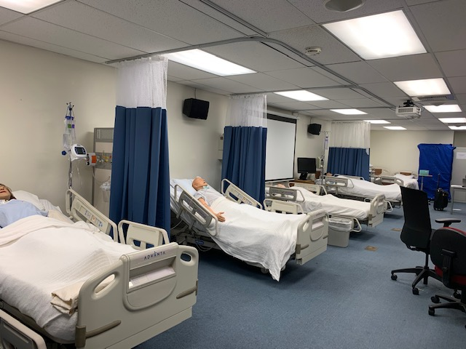
Chaffey College Vocational Nursing
3 Semester Program
Accredited Since 1951 - Current Accreditation May 2024 - 2028
Board of Vocational Nursing and Psychiatric Technicians
2535 Capitol Oaks Drive – Suite 205
Sacramento, CA 95833
Telephone Number: (916) 263-7800

Slide 4
Admission Requirements
Admission to Chaffey College
Completion of all pre-requisites
Completion of Health Examination to include current TB testing and relevant disease titers
Satisfactory Background Check
CPR Certification
  American Heart Association – BLS ONLY
Notes:
Will be admitted to program prior to completion of some of these things, but they must be completed by the due date or your position will be given to the next on wait list.

Slide 5
PRE-REQUISITES
Certified Nursing Assistant (Current and Active)
  High School Diploma or Equivalent
Foreign credentials must be evaluated.
BIO 424: Must be completed by the time of application (5-year limitation applies). BIO 424L is optional. Minimum GPA of 2.0 required.
BIO 20 and BIO 22 may be taken as alternatives to BIO 424.
For the next application cycle, the cutoff date for BIO 20, BIO 22, or BIO 424 is Summer 2025

Slide 6
RECOMMENDED COURSES STARTING OCTOBER 14
Medical Terminology (HS-30)
  Course that provides a great foundation for anatomy and physiology
Gerontology (provides enhanced training for future healthcare providers)
  GERO-11 (Introduction to Gerontology)
    B or better earns preferred consideration for CNA program acceptance
  GERO-18 (Aging and the Life Course)
  GERO-22 (Dying and Death)
  GERO-23 (Aging and Older Adulthood)
Questions about these classes? Contact Dr. Jeff Laguna at jeffrey.laguna@chaffey.edu

Slide 7
If you are interested in registering for these recommended courses (not required), please email Counselor Celeste.Mor@chaffey.edu for assistance with registration.

Slide 8
Important Information
For the Fall application period (October) for a January start, all prerequisites must be completed to apply. For the Spring application period (March) for an August start, prerequisites may be in-progress at the time of application
All of our VN classes are IN-PERSON, no virtual classes or clinicals would be held

Slide 9
APPLICATION TO THE VN PROGRAM
The program begins each Fall and Spring semester.
Applications are accepted during October and March.
Two-Part Online Application Process for next cycle:
Transcript Evaluation: FALL 2025: 09/08/25 - 10/24/25
Application Submission: FALL 2025: 10/01/25- 10/31/25
The application link and other application information can be found on the VN program's website under the Application Process and Forms Section.
Up to 24 applicants will be accepted through a random lottery
Notes:
The transcript evaluation link will go active on sept 9th. You must be enrolled at Chaffey college and have a student ID. Transcript evaluation can be accessed through your Chaffey Portal For fall application period, all the prerequisites must be done prior to applying. For spring application, the courses can be in “ progress” .

Slide 10
Important Application Dates/Time
Evaluation period for FALL 2025:
09/08/25 – 10/24/25
Application period for FALL 2025:
10/01/25 - 10/31/25
Please contact and make an appointment with our Counseling Department for transcript evaluation

Slide 11

Visit the Chaffey College, Counseling Department website
Feel free to screenshot the Counseling Department website link: https://www.chaffey.edu/counseling/index.php
Call the Counseling Department Front Desk for appointment assistance at (909) 652-6200.

Slide 12

UNIFORM POLICY
Dove Apparel
School Patch
Polishable Shoes
Uniforms are also available at the bookstore. Must order by the deadline to receive free shipping.
Notes:
School Uniform (no exceptions) These are ordered through DOVE Apparel
School Program Patch
Shoes – White and polishable
Guidelines for hair, jewelry, etc.

Slide 13
ATTENDANCE POLICY
Absences
Tardiness
Excessive absences or tardiness may result in the student being dropped from the program

Slide 14
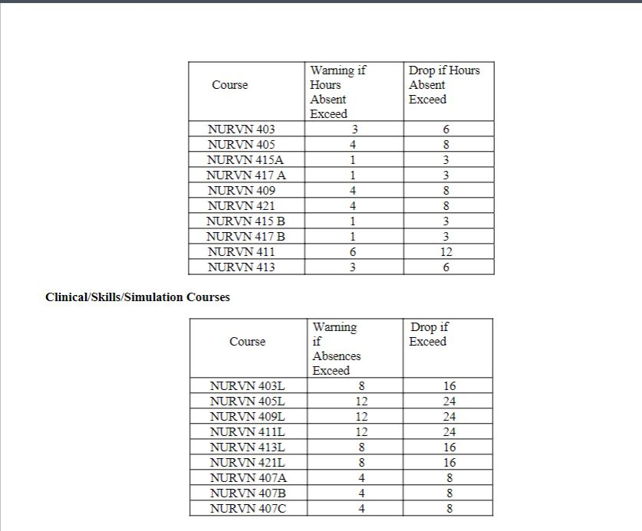

Slide 15
TIME MANAGEMENT
STUDY HABITS
WORKING WHILE IN THE VN PROGRAM
The program runs Monday through Friday for the full year.
Shifts: 12-hour shifts, including night and weekend shifts.
Clinical sites may be in Inland Empire and Orange County
Financial Aid Considerations: The next financial aid cycle for the academic year 2025-2026 opens on October 1st.

Slide 16
COSTS
Tuition and Fees: $2360 (approx.)
Books, Background check and Health requirements: $800 (approx.)
Uniforms and Supplies: $300 (approx.)
TOTAL for PROGRAM: $3460 (approx.)
Additional costs for licensure: $550 (approx.)

Slide 17
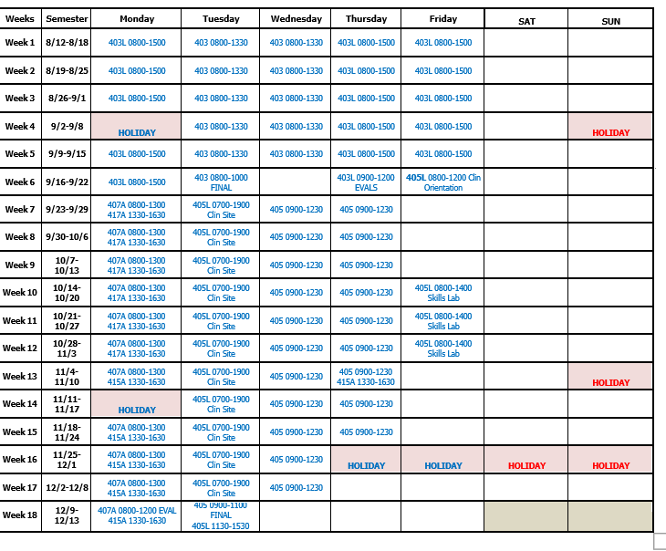

Slide 18
Misc Information
Credit for Prior Learning: Consult with the program director for information on credit granting for prior learning.
Support Courses: Ensure all required support courses are completed.
COVID-19-Related Issues: Adhere to any program-specific COVID-19 protocols.
Vaccines: Vaccinations are required for participation in the program.
Clinical Site Availability: Clinical site availability may affect your schedule.
Testing: If testing is required, it is the responsibility of each student to complete it.
Deadlines: Failure to meet deadlines may result in your application being withdrawn and the offer extended to an alternate candidate.

Slide 19
Chaffey College Admissions & Records
https://www.chaffey.edu/counseling/index.php
sade.stephenson@chaffey.edu for CPR renewal

Slide 20

Questions?

