Slide 1

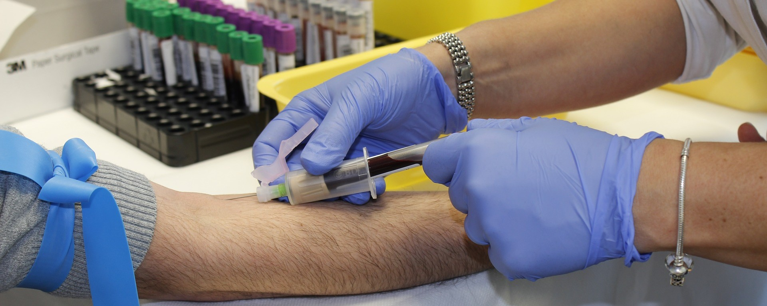
Information Session Fall 2024
Fontana Campus

Slide 2

Welcome!
Dr. Eric Sorenson
Dean, Health & Wellness
Sade Stephenson, CNA & Phlebotomy
Program Director, Health & Wellness Non-Credit Programs
Sade.stephenson@chaffey.edu
Susie Haynes
Administrative Assistant II, Health & Wellness
Suzanne.Haynes@chaffey.edu
Gabriela Vallejo
Counselor, gabriela.vallejo@chaffey.edu

Slide 3
Chaffey College Phlebotomy Technician Program
Approved by the California Department of Public Health (CDPH)
Fulltime option (Fontana Campus)
One semester (Fall 2024)

Slide 4
ROLE OF A Phlebotomist: Scope of Practice
Phlebotomist:
A phlebotomist is a medical professional who is trained to perform blood draws on children and adults. They collect and prepare blood for testing so it can be analyzed in a medical laboratory. They also collect blood for donation.
Work in a team environment with other CNAs, nurses, physicians, family members, etc.
Within the job will need strong foundation of safety principles, ergonomics, infection control, legal information (patients rights, rules and regulations, HIPPA, etc.), ethics

Slide 5
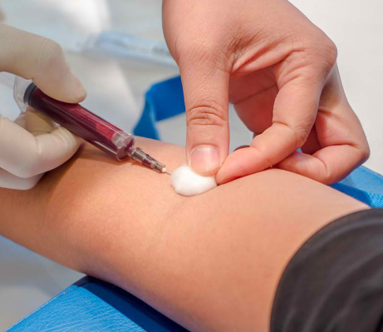
Advantages of becoming a Phlebotomist:
Phlebotomist are direct care members of the healthcare team
To work in hospitals, ambulatory clinics, urgent care, or mobile services
A Phlebotomy certification is required as a pre-requisite for employment
Experience is beneficial for additional educational programs, ex: Nursing

Slide 6
What are the requirements for the Phlebotomy Technician Program?
Valid US Social Security Number or Tax ID number (TIN) is required.
Required by DOJ fingerprinting to enter the program (CDPH) and for licensure testing
Clear criminal background and drug screening to participate in clinicals.
Completed after provisional acceptance to the program
Valid CPR card. This must be the “BLS” from the American Heart Association. Renews every 2 years
Health clearance (completed after provisional acceptance)
Immunizations/flu shot and others as required by clinical facilities (subject to change)
High School Transcripts

Slide 7
Application Process
Must attend an information session
Must be 18 years old
Complete health requirements
Clear drug screen
Clear background check
High School Transcripts
Must be enrolled at Chaffey college with a student ID (if you have not attended classes within the last year, you must reapply as a student)

Slide 8
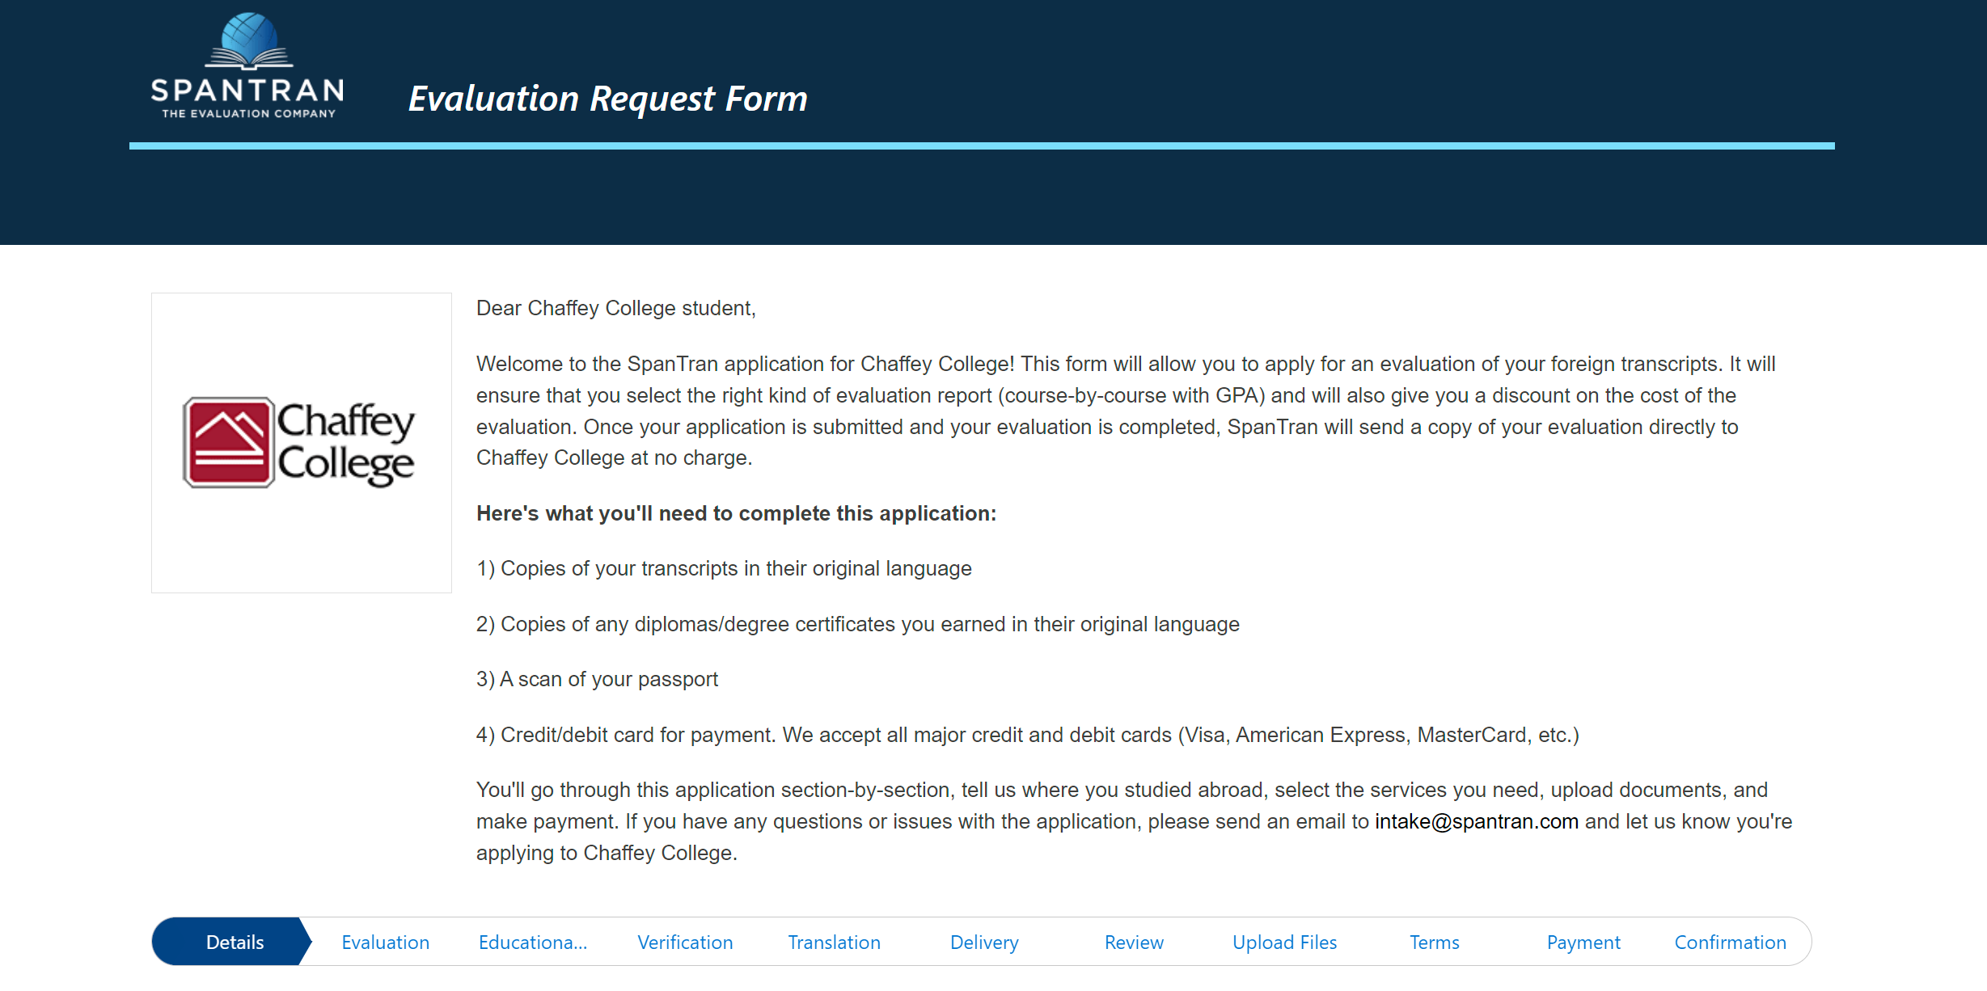
High School Transcripts
If you are unable to upload a copy of your unofficial high school transcripts or have a GED, you will need to have your high school documents evaluated by an outside professional agency from Chaffey College to determine U.S. high school equivalency.
Please indicate that you want the detailed equivalency report.
There is a small fee you must pay and once completed, your evaluation report will be sent to Chaffey College's Admissions & Records Office.
The transcript link will be provided

Slide 9
Information:
Must have transportation to and from class and clinical site
Must enroll in and pass all three courses

Slide 10

3 Phlebotomy Technician Courses (10 week course)
Phleb 600 Theory (Mondays)
Phleb 605 Skills Lab Practice
Phleb 600L Clinical (2x per week)

Slide 11
*Sample Phlebotomy Schedule
Monday | Tuesday | Wednesday | Thursday | Friday
PHLEB 600 Theory 9am-3:50pm | PHLEB 600L Clinic (Cohort 1) 8am – 3:15pm PHLEB 600L Clinic (Cohort 2) 8am – 3:15pm | PHLEB 600L Clinic (Cohort 1) 8am – 3:15pm PHLEB 600L Clinic (Cohort 2) 8am – 3:15pm | PHLEB 600L Clinic (Cohort 3) 8am – 3:15pm PHLEB 605 Skills Lab 4pm – 6:25pm | PHLEB 600L Clinic (Cohort 3) 8am – 3:15pm PHLEB 605 Skills Lab 4pm – 6:25pm

Slide 12
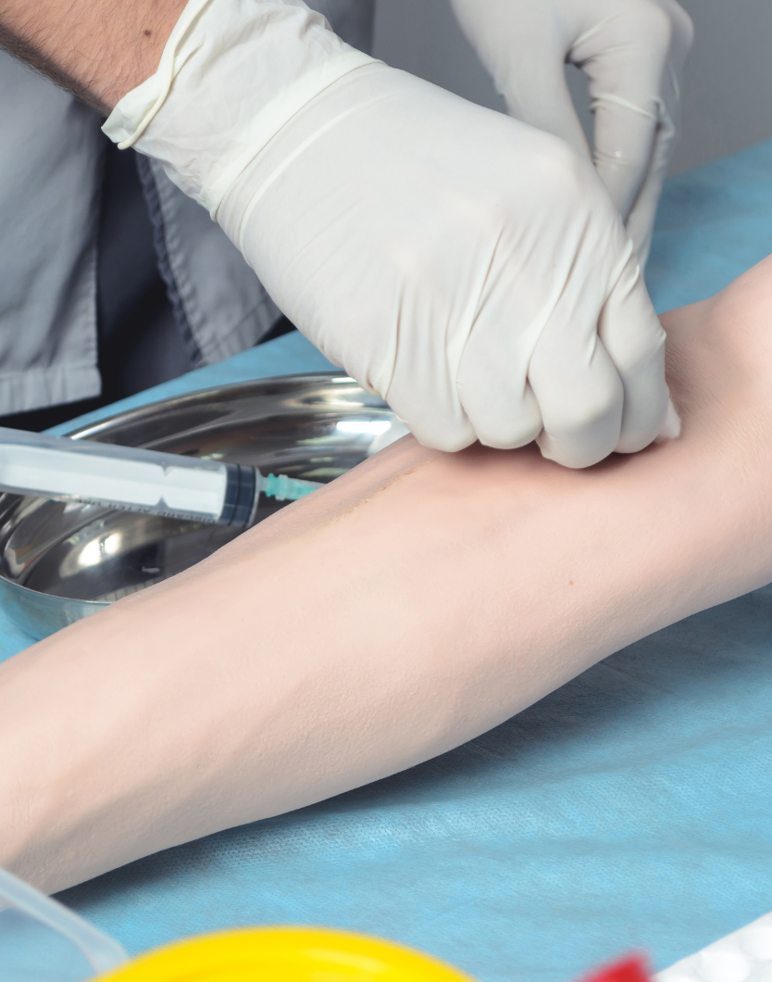
Health Requirements
TB clearance (2-step TB or TB Gold or CXR no more than 3 years old)
Chaffey College Health Sciences physical form signed by physician, NP or PA
Immunizations and titers per clinical sites, varies (MMR, varicella titers, Hep B, flu, COVID, tetanus, etc.)

Slide 13
What are the requirements I need to apply to the Phlebotomy Technician program?
Submit an application of admission to Chaffey College if you are not a current student at www.chaffey.edu, then click Prospective Students ---> Application link.
The Phlebotomy Technician application link will be emailed to individuals who attended an information session
The Phlebotomy Technician application link will go live 2/22/2024
Fall 2024 Applications available.

Slide 14
Application Filing period
February 22-April 5, 2024 , for a Fall 2024 start.
Complete all sections and submit online

Slide 15
How much does the program cost?
Maroon Scrub Top | $15.50
Black Scrub Pants | $15.50
Textbook | $30.00
Workbook | $14.00
Exam Testing Fee | $125.00
Livescan Fingerprinting | $50.00
Complio (Health Screening upload, drug screening, background check, & proof of CPR ecard) | $130.00
Estimated Costs
Total Additional Fees = $380
Course Tuition = Free
This is just an estimate, costs may vary by student and class

Slide 16
Schedules: Fulltime Only (10 weeks)
* CLINICALS will be at local hospital clinic
4:00 PM – 8:00PM Skills Practice
Fontana Campus
7:30 PM – 3:30 PM
Clinical Site 2x per week (Tues & Wen OR Thurs & Friday)
THEORY
9AM-3:50PM @ FONTANA CAMPUS

Slide 17
What can I do while I am enrolled in the Phlebotomy Technician?
HS 30 | Medical Terminology
BIOL 424 | Anatomy/Physiology
CHEM 10 | Introduction to Chemistry
COMSTD 4 | Interpersonal Communication
ENGL 1A | Composition
Foreign Language | American Sign Language, Arabic, Chinese, French, Spanish
GERO 11 | Introduction to Gerontology
GERO 404 | Health and Wellness for older adults
GUID 2 | Essentials of Student Success (study skills)
GUID 3 | Career Exploration and Life Planning
NF 5 | Nutrition for Life
PH 401 | Comm Health Worker Principles I
PH 402 | Comm Health Worker Principles II
PSYCH 25 | Lifespan Developmental Psychology

Slide 18
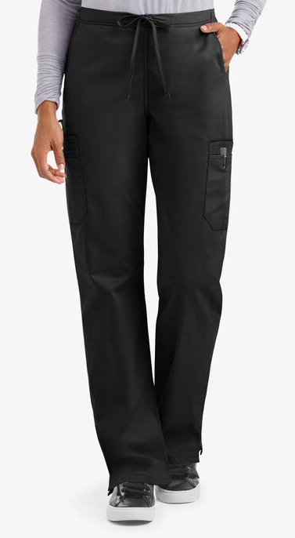
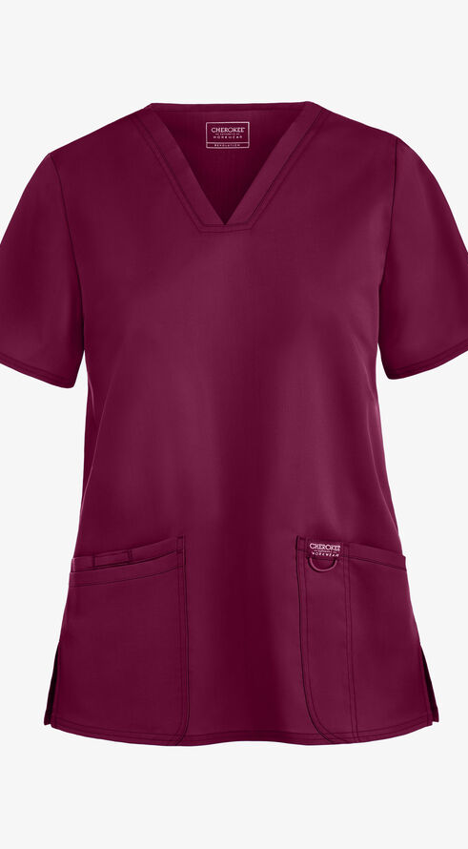
Uniforms/Dress Code
Maroon colored scrub top & Solid black scrub pants
Solid black socks that cover the ankles
Solid black, skid free, waterproof shoes, no open toes or backs, no straps, no heels, no openings
No artificial or gel nails, no visible tattoos or piercings (except students in both ears lower lobe). Nails no longer than fingerprints.
Hair accessories must match hair color, hair must be natural color

Slide 19
Information regarding the phlebotomy technician scope of practice and NHA licensure testing can be obtained from the following agencies
California Department of Public Health (CDPH)
www.cdph.ca.gov
Licensing and Certification Program Branch
www.nhanow.com
Home | National Healthcareer Association | Allied Health Certifications (nhanow.com)
National Healthcareer Association

Slide 20

Next Steps
*** High School Students: Obtain your 7-digit student ID number by submitting a Chaffey College Application and submit an HSP enrollment form.
Apply
Apply to Chaffey College to receive a student ID number.
Download and Read through
Download and read through the Application Instructions, which will be emailed to you.
Submit
Reach Out
Reach out if you need application assistance or other Chaffey College resources.
Completed FALL 2024 Phlebotomy Technician application. February 22-April 5, 2024

Slide 21

SAVE THE DATES
*** High School Students: Obtain your 7-digit student ID number by submitting a Chaffey College Application and submit an HSP enrollment form.
Application
Apply to the program February 22-April 5, 2024
Applicants are selected
Randomized selection process; 24 seats Fontana. 10 Alternates are also selected
Attend a Prescreening
Student Registration
5/2/2024 @ 4:00pm Fontana Campus; In person Course Registration for Fall 2024
4/18/2024 3:30pm @ Rancho Campus, Health screening process begins. Please bring laptop, and payment information to purchase access to Complio

Slide 22
Who to contact?
CNA application, general questions- H&W Administrative Assistant
Susie Haynes, suzanne.haynes@chaffey.edu, (909) 652-6669
Complio or health requirements- Clinical Coordinator
Sharon Lehman sharon.lehman@chaffey.edu (909) 285-1958
Counseling- Gabriela Vallejo, gabriela.vallejo@chaffey.edu
Dual enrollment process- DE Administrative Assistant
Candice Brock, dual.enrollment@chaffey.edu, (909) 652-6154
Purchasing uniforms and supplies- Campus store
bookstore.staff@chaffey.edu, (909) 652-6560
Sade Stephenson, Program Director- sade.Stephenson@chaffey.edu

Slide 23

Feel free to ask questions!

