Slide 1
Chaffey College CNA Program
Information Session 2024

Slide 2
Welcome!
Dr. Eric Sorenson Dean, Health & Wellness
Sade Stephenson, CNA & Phlebotomy Program Director, Health & Wellness Non-Credit Programs Sade.stephenson@chaffey.edu
Susie Haynes Administrative Assistant II, Health & Wellness Suzanne.Haynes@chaffey.edu
Gabriela Vallejo Counselor
Gabriela.vallejo@chaffey.edu

Slide 3
Chaffey College Nursing Assistant Program
Approved by the California Department of Public Health (CDPH)
Approved NATP State testing Site- Chino Campus (Fee is currently $120)
Full Semester 18 weeks

Slide 4
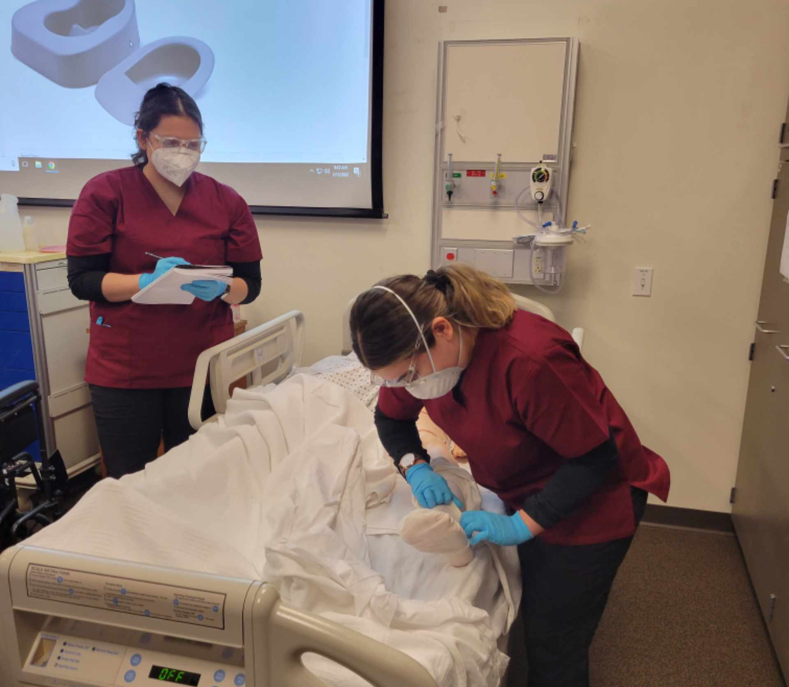
Advantages of becoming a CNA:
CNAs are direct care members of the healthcare team that report to a licensed nurse (LVN or RN)
They have a scope of practice in CA and may perform duties within that scope of practice only (Title 22, Section 5, Chapter 2.5)
To work in a subacute, skilled nursing or long-term care facility, you must have an active CNA state certificate
A CNA certification is required as a pre-requisite to Chaffey’s LVN & ADN programs

Slide 5
ROLE OF A CNA: Scope of Practice
CNAs:
Perform activities of daily living skills such as washing a resident's hair, bathing, feeding, dressing, elimination, transferring (walking, walkers, wheelchairs, crutches, braces), checking vital signs, positioning, brushing teeth or dentures, etc.
Within the job will need strong communication skills including for those with dementia and Alzheimer’s, head injuries (strokes), within the grieving process, mental health issues
Work in a team environment with other CNAs, nurses, physical therapists, dieticians, family members, occupational therapists, social workers, etc.
Within the job will need strong foundation of safety principles, ergonomics, infection control, legal information (patients rights, rules and regulations, HIPPA, etc.), ethics

Slide 6
Licensed Vocational Nurse (LVN license)
Certified Nursing Assistant (Certificate)
Associate’s degree in Nursing (ADN)
Bachelor Degree in Nursing (BSN)
Master's in Nursing (MSN)/APN/NP
Doctorate in Nursing Practice (DNP) Or PhD in Nursing Research
Career Ladder

Slide 7
What are the requirements for the Nursing Assistant Program?
Valid US Social Security Number or Tax ID number (TIN) is required.
Required by DOJ fingerprinting to enter the program (CDPH) and for state CNA testing
Clear criminal background and drug screening to participate in clinicals.
Completed after provisional acceptance to the program
Valid CPR card. This must be the “BLS” from the American Heart Association. Renews every 2 years
Health clearance (completed after provisional acceptance)
Immunizations/flu shot and others as required by clinical facilities (subject to change)

Slide 8
Application Process
Must attend an information session
Must be 16 years old
Complete health requirements
Clear drug screen
Clear background check
Must be enrolled at Chaffey college with a student ID (if you have not attended classes within the last year, you must reapply as a student)

Slide 9
Information:
No high school diploma or GED required
Must have transportation to and from class and clinical site
Must enroll in and pass all four courses

Slide 10
A program that allows high school students to enroll and earn college credit in courses taught by college faculty
Dual Enrollment Program
High School Partnership (HSP): Students in the following school districts are auto-registered in cost-free courses:
Non-High School Partnership (Non-HSP):
Out-of-district students must self-register in courses, and are responsible for the cost of college service fees and textbooks. (Tuition is waived)
Students must get parent permission and approval from the high school to participate in the Dual Enrollment Program.
High School Dual Enrollment

Slide 11
Obtain your 7-digit student ID number by submitting a Chaffey College Application and submit an HSP enrollment form IMPORTANT: Parent permission and High School Counselor approval is required on all enrollment forms
High School Dual Enrollment Process
NEXT STEPS
HSP: High School Partnership Keep the email confirmation stating what courses have been approved to take. Admissions & Records will register you in the CNA courses. Proceed with the CNA Program application process Once the application process is complete, the HSP Program will cover the cost of textbooks and materials. | NON-HSP: Non-High School Partnership Keep the email confirmation stating what courses have been approved to self-register in. Self-register in approved CNA courses using “How to Self-Register” video tutorial. IMPORTANT: Non-HSP students are responsible for the cost of textbooks and materials.

Slide 12
What are the requirements I need to apply to the Nursing Assistant program?
Submit an application of admission to Chaffey College if you are not a current student at www.chaffey.edu, then click Prospective Students ---> Application link.
The Nursing Assistant application link will be available to individuals who attended an information session
The Nursing Assistant application link will go live February 22, 2024- April 5, 2024

Slide 13
Nursing Assistant Application Filing period
February 22-April 5, 2024 for a Fall 2024 start.
Complete all sections and submit online

Slide 14
How much does the program cost?
Maroon Scrub Top | $15.50
Black Scrub Pants | $15.50
CNA Kit (includes blood pressure cuff, stethoscope, gait belt, bath basin, bedpan, silicone band watch, and tote bag.) | $90.50
Textbook | $76.50
Workbook | $24.00
CNA State Exam Testing Fee | $120.00
Livescan Fingerprinting | $50.00
Physical Exam | $varies
Complio (Health screening upload immunizations, cpr, drug screen & background check) | $130
Estimated Costs
Total Additional Fees = 525
Course Tuition = Free
This is just an estimate, costs may vary by student and class

Slide 15
Prescreening Health Requirements
TB clearance (2-step TB or TB Gold or CXR no more than 3 years old)
Chaffey College Health Sciences CNA physical form signed by physician, NP or PA
Immunizations and titers per clinical sites, varies (MMR, varicella titers, Hep B, flu, COVID, tetanus, etc.)

Slide 16
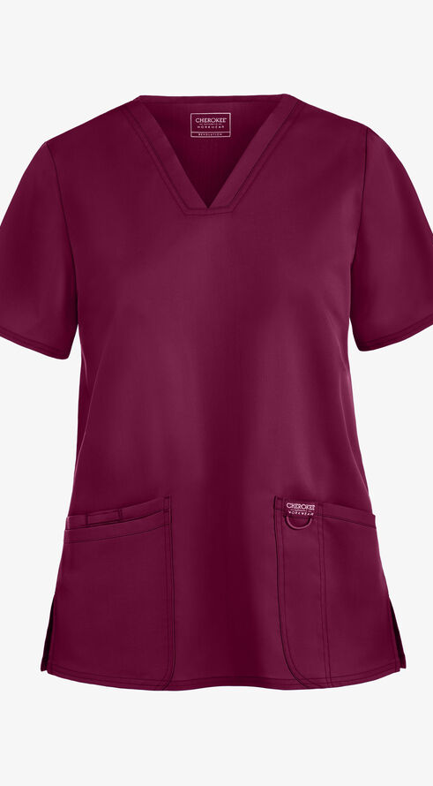
Uniforms/Dress Code
Maroon colored scrub top & Solid black scrub pants
Solid black socks that cover the ankles
Solid black, skid free, waterproof shoes, no open toes or backs, no straps, no heels, no openings
Watch with a second hand on the wrist (no smart watches)
No artificial or gel nails, no visible tattoos or piercings (except students in both ears lower lobe). Nails no longer than fingerprints.
Hair accessories must match hair color, hair must be natural color

Slide 17
Schedules: Full-time 18 WEEKS
FULL SEMESTER
4:00 PM – 8:00 PM
FULL SEMESTER FONTANA & Chino 3 EVENINGS A WEEK 18 WEEKS; Clinical on Saturdays only
FONTANA & CHINO LOCATIONS
* CLINICALS WILL BE 6:45AM –2:25PM*

Slide 18
What can I do before I enter the Nursing Assistant Program?
HS 30 | Medical Terminology
BIOL 424 | Anatomy/Physiology
CHEM 10 | Introduction to Chemistry
COMSTD 4 | Interpersonal Communication
ENGL 1A | Composition
Foreign Language | American Sign Language, Arabic, Chinese, French, Spanish
GERO 11 | Introduction to Gerontology
GERO 404 | Health and Wellness for older adults
GUID 2 | Essentials of Student Success (study skills)
GUID 3 | Career Exploration and Life Planning
NF 5 | Nutrition for Life
PH 401 | Comm Health Worker Principles I
PH 402 | Comm Health Worker Principles II
PSYCH 25 | Lifespan Developmental Psychology

Slide 19
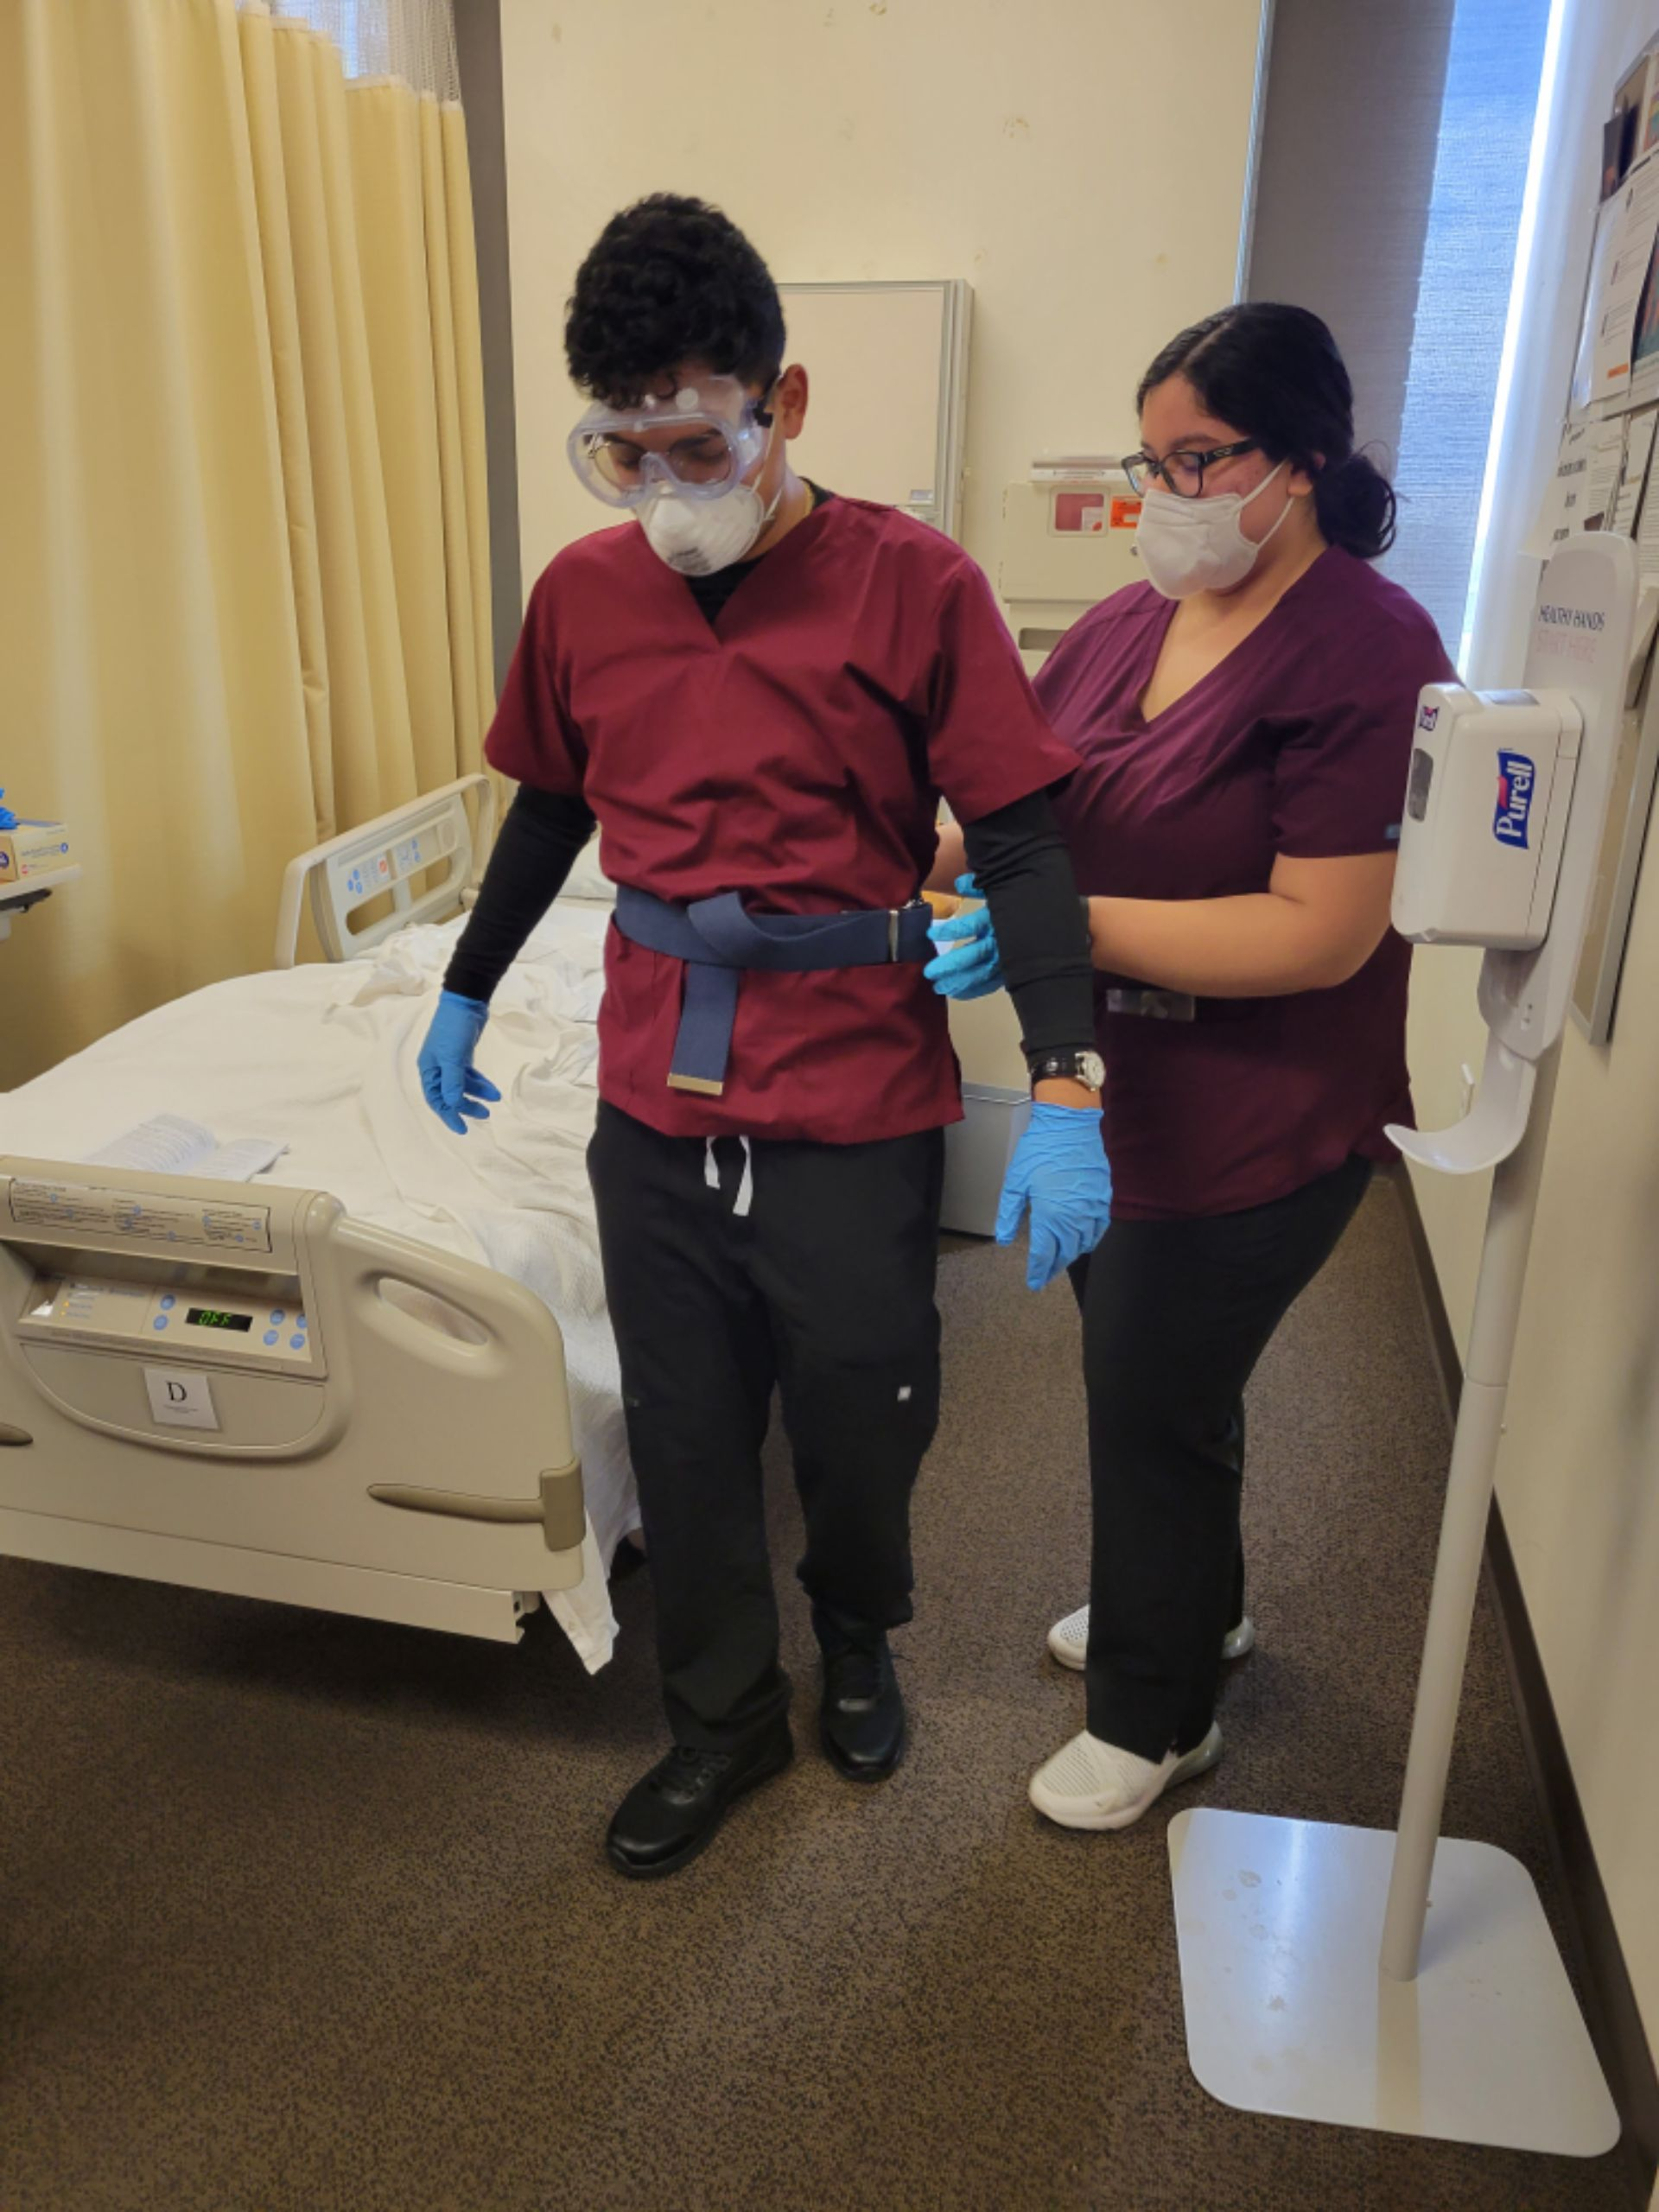
3 Nurse Aide Training Courses
NURAST 600 Theory Lecture (63 hours in person)
NURAST 600L Clinical (106 hours in an SKILLED NURSING FACILITY ONTARIO OR SAN BERNANDINO)
NURAST 605 Skills Lab ( 48 hours on campus in skills lab)

Slide 20
SAMPLE COURSE SCHEDULE FALL 2024
FONTANA
Sunday | Monday | Tuesday | Wednesday | Thursday | Friday | Saturday
 |  | NURAST 605L (cohort 1) Skills Lab 4:30pm – 7:20pm | NURAST 605L (cohort 2) Skills Lab: 4:30pm – 7:20pm | NURAST 600 Theory 4pm-7:25pm |  | NURAST 600L Clinic 7am – 2:25pm
CHINO
Sunday | Monday | Tuesday | Wednesday | Thursday | Friday | Saturday
 | NURAST 605L(cohort 1) Skills Lab 4:30pm - 7:50pm | NURAST 600 Theory 4pm-7:25pm | NURAST 605L (cohort 2) Skills Lab 4:30pm - 7:20pm |  |  | NURAST 600L Clinic 7am – 2:25pm

Slide 21
Information regarding the nursing assistant certification/scope of practice and NNAAP state testing can be obtained from the following agencies
California Department of Public Health (CDPH)
www.cdph.ca.gov
Licensing and Certification Program Branch
National Nursing Aide Assessment Program (NNAAP)
www.ncsbn.org
Regional Testing Center: www.regionaltestingcenter.org

Slide 22
Next Steps
*** High School Students: Obtain your 7-digit student ID number by submitting a Chaffey College Application and submit an HSP enrollment form.
Apply
Apply to Chaffey College to receive a student ID number.
Download and Read through
Download and read through the CNA Application Instructions, which can be found on the Chaffey College CNA website.
Submit
Submit a completed Fall 2024 Certified Nursing Assistant (CNA) Program application. February 22-April 5,2024
Reach Out
Reach out if you need application assistance or other Chaffey College resources.

Slide 23
Selection Process SAVE THE DATE
*** High School Students: Obtain your 7-digit student ID number by submitting a Chaffey College Application and submit an HSP enrollment form.
Application
Apply to the program February 22-April 5, 2024
Applicants are selected
Randomized selection process; 30 seats for Chino and 30 seat for Fontana. 30 Alternates are also selected
Attend Prescreening
4/18/2024 3:30pm @ Rancho Campus, Health screening process begins. Please bring laptop, and payment information to purchase access to Complio
Student Registration
5/2/2024 @ 2:00pm Fontana Campus; In person Course Registration for Fall 2024

Slide 24
Who to contact?
Dual enrollment process- DE Administrative Assistant Candice Brock, dual.enrollment@chaffey.edu, (909) 652-6154
CNA application- HS Administrative Assistant Susie Haynes, suzanne.haynes@chaffey.edu, (909) 652-6669
Complio or health requirements- Clinical Coordinator Sharon Lehman sharon.lehman@chaffey.edu (909) 285-1958
Counselor: Email me for an appointment
Gabriela Vallejo, gabriela.vallejo@chaffey.edu
Purchasing uniforms and supplies- Campus store bookstore.staff@chaffey.edu, (909) 652-6560

Slide 25
CNA Application Link: Please scan Feel free to ask questions! sade.stephenson@chaffey.edu Program Director

