Slide 1


Chaffey College
School of Health Sciences
Associate Degree Nursing (ADN)
Rancho Cucamonga Campus

Slide 2

Chaffey College Associate Degree Nursing Program
Approved by the California Board of Registered Nursing
Accredited by the Accrediting Commission for Education in Nursing www.acenursing.org
NCLEX pass rates consistently above the national average
ADN program respected and supported by the community.

Slide 3

Have you done your research?
Employment Outlook (data covers San Bernardino, Riverside, Orange, & LA counties)
Regional Job Outlook
  All regions provide many annual job opportunities
    Most numerous in LA county, followed by Inland Empire, then Orange Co.
Regional Hourly Wages (2022 data)
  Wages are high, with median hourly rates ranging from $55+ per hour.
General Medical/Surgical Hospitals employ the majority of RNs.
Source: ADN August 2022 Needs Assessment, Chaffey College Institutional Research.

Slide 4
Registered Nursing Programs
2-3 semester program following transition class NURADN 3/3L
4 semester program after prerequisite courses completed
Associate’s degree in Nursing (ADN)
LVN to RN Degree Option
Advanced Placement Military Option
Advanced placement based on past military medical background
Successful completion of these programs will allow you to take the state exam (NCLEX) for licensure as a Registered Nurse in the State of California.

Slide 5

ADN Selection Process Changes
  Multi criteria point system : 80% of spaces will be selected by rank order (highest points)
      20% of spaces will be selected by random selection from qualified applicants.
Any information in this presentation is subject to change.

Slide 6
What are the requirements I need for the nursing program?
Valid US Social Security Number or Tax ID is required.
  Required by the clinical faculties
Clear criminal background and drug screen to participate in clinicals.
  Completed after provisional acceptance to the program.
Valid CPR card. This must be the “BLS” from the American Heart Association.
Health clearance (completed after provisional acceptance).
Verification of Health Insurance
Immunizations and Flu shot current

Slide 7
Applicants to ADN program must meet the following requirements:
High School transcripts, GED, High School Proficiency Exam
Official Transcripts from all colleges attended.
International transcripts (high school) must be evaluated by an evaluation company before submission to Chaffey College. Please ask for a “detailed evaluation report”.
  Contact Admissions & Records office at 909-652-6600, or visit their updated website, for a list of approved evaluation agencies.

Slide 8

General Education requirements
Students are encouraged to complete general education courses prior to applying to the program.
Completing all general education courses before applying greatly increases chances of being accepted.
  prioritization in the selection process is given to students who have all their general education courses completed.

Slide 9
ADN Nursing Program Prerequisites:
Effective Fall 2019 application period
These courses must be completed before applying
Required Pre-requisite courses Minimum GPA combined must be at least 2.8 May repeat only ONE science course Ten year recency for Bio 22, 23 and 23L NO recency for Advanced Placement (LVN-RN)!! | Pre-requisites for biology courses
Biol 20 Anatomy (4) | Eligibility for English 1A
Biol 22 Physiology (4) | Biol 20 & Chem 9 or 10 OR 1 year of High School Chemistry
Biol 23 Microbiology (3) | Biol 22 or Biol 61
Biol 23L Microbiology Lab (2) | Corequisite Biol 23

Slide 10

MATH 401
Frequently Asked Questions..
Math 401 is a 1 unit course for nursing math that is specific to health care
Offered in Fast-track formats year-round
Cannot be waived with other math courses
For similar courses at other colleges meet with a counselor

Slide 11
ADN Required General Ed courses:
Students with all courses completed will be prioritized over students with in progress courses
Required Gen Ed courses Minimum GPA for combined Gen Ed requirement listed below must be 3.0
Math 401 Math for Health Sciences (1)
Psych 25 Developmental (Lifespan) Psychology (3)
Soc 10 (Intro to sociology) OR Anthro 3 (Social & Cultural anthropology) OR Comstd 74 (Intercultural Communication). These courses meet American Institutions requirement for graduation
Comstd 2, 4, 6, 8
Humanities Area/Art/Humaities
Ethnic Studies
Math 420 OR Math 450 or higher OR Proficiency as stated on Chaffey Mathematics assessment results
Engl 1A Composition (3). Prerequisite: Engl 495 or Chaffey Assessment

Slide 12

Enrollment Criteria for 1st semester
Based on Chancellors Office criteria
Points awarded based on criteria in each of the following categories.
Please refer to the ADN Enrollment Criteria form under the Entrance tab on the website
  https://www.chaffey.edu/healthsciences/nursing/nursingadn/pdfs/multi-criteria-selection-process.pdf

Slide 13
ADN TEAS exam information
Test for Essential Academic Skills (ATI TEAS 7 edition)
www.atitesting.com – for study guide and online practice $$$
Approximately 35-50 qualified applicants per semester are invited to take the TEAS test for free at Chaffey College.
  Applicants with the highest total multicriteria scores are invited to take the TEAS test.
The test is a four part assessment with subjects in Reading, Mathematics, Science, English and Language
  170 questions, 3 hour and 29 minute computerized test.

Slide 14

ADN TEAS exam information
Students must pass with a composite score of 62 and above
Only the first passing score is accepted
Students must pass the TEAS test prior to program enrollment.
Students not passing the TEAS test will be required to complete a remediation plan, then reapply to the program to re-take the TEAS.
The student is allowed 2 attempts to successfully pass the test.
Students who have taken the TEAS exam in the past year.
  attach the unofficial results with the application.
  If selected for admission, you must arrange for ATI to electronically send your test results to the nursing department.

Slide 15
What are the requirements I need to apply to the ADN program?
Submit an application of admission to Chaffey College if you are not a current student at www.chaffey.edu, then click Application link
  https://www.chaffey.edu/counseling/pdfs/adn-app-instructions.pdf
Submit all official college/university coursework to Admissions at the Rancho Cucamonga campus (2 months prior to application period)
Complete a Request for Evaluation of transcripts form 6 weeks prior to the ADN application period.
  This MUST be completed in order to receive a copy of the External/Chaffey Transcript Evaluation.

Slide 16

ADN Application Filing period
During the months of March and September.
Download and print the application at the ADN website:
  https:www.chaffey.edu/heathsciences/nursing/nursingadn/adnapplication.shtml
Complete all sections and submit online
Submit a copy of External/Chaffey Transcript Evaluation with the application.

Slide 17
How much does the program cost?
Nursing Program Tuition $ 2,045
Parking $ 200
Fees $ 829
Uniforms $ 203
Books $ 1,790 for 2 years
Supplies $ 853
Assessment Testing $ 540
Total estimated cost = $ 6,500
Estimated cost 1st semester: $ 2,800
Refer to Handbook on website for additional information

Slide 18

ADN Course Sequence: 37.5 units
1st semester
  NURADN 6 Nursing Skills (1.5)
  NURADN 15 Nursing process 1 (7.5)
2nd semester
  NURADN 28 Nursing process 2 (7.5)
  NURADN 29 Maternal Newborn (2)
3rd semester
  NURADN 35 Nursing process 3 (7.5)
  NURADN 39 Family Child nursing (2)
4th semester
  NURADN 47 Nursing process 4 (7.5)
  NURADN 49 Mental Health nursing (2)

Slide 19
LVN to RN Degree Option:
Advanced Placement
12-18 month full time program
Multi-criteria does not apply
Ranked based on TEAS score of admittance
No expiration of science courses
Application period is the same as first year ADN applicants.
Advanced placement LVN students are exempt from the ADN Enrollment Criteria
Must have an active LVN license
Complete NURADN 3 and 3L with a minimum grade of C prior to application.
Entrance based on space available into 2nd or 3rd semester

Slide 20

BSN Partnerships
Students have the opportunity to complete units of the RN-BSN nursing coursework.
Become familiar with the required RN-BSN program coursework
Complete your BSN in a shorter timeframe.
Concurrent enrollment:
  Cal State San Bernardino
  (limited to 20 students each Fall term)
  Grand Canyon University (no limit and start anytime)
Articulation agreements with:
  Cal State Fullerton
  Cal State San Marcos
  Azusa Pacific University
  Aspen University

Slide 21

Concurrent Enrollment
The Chaffey College, ADN to CSUSB, BSN Concurrent Enrollment Pathway (CEP) was created in response to the Institute of Medicine’s goal to increase the number of BSN degree graduates to 80% by 2020.

Slide 22


CSUSB concurrent enrollment benefits for students
Students will be provided with the option of an accessible pathway for completing a BSN degree within six (6) months for full time students after graduating with their Chaffey’s ADN Program.
Students will receive quality instruction and support from Chaffey College ADN faculty and CSUSB’s Nursing faculty.
Students are concurrently admitted to both programs and take courses for both institutions onsite at Chaffey College or online.
Students will save costs with additional built-in support from CSUSB’s and Chaffey College’s Financial Aid Departments working collaborating to assist students with their funding.
MUST have all GE completed and be GE certified for CSUSB program only
Notes:
• Average completion time from ADN to BSN is over 8 years

Slide 23
What can I do while waiting to get into a nursing program?
Get training to be a CNA or EMT or medical assistant
Take classes in second language
Volunteer
Take additional classes toward the BSN.
Get your GE certified for Concurrent Enrollment!
Take a nursing support class to help you succeed in Nursing: (see ADN Entrance Criteria)
  NURADN 403 Pathophysiology for Nurses
  NURADN 428 Pharmacology
  HS 30 Medical Terminology
  GERO 18 Aging and Life Cycle
  GERO 22 Dying and Death
  GERO 23 Aging and Older Adult

Slide 24

Frequently asked questions
Should I take the support courses?
  Yes, they are recommended and provide a good base for your learning
Should I apply with In process courses?
  No, you should wait to apply until all courses are complete so you are ranked higher

Slide 25
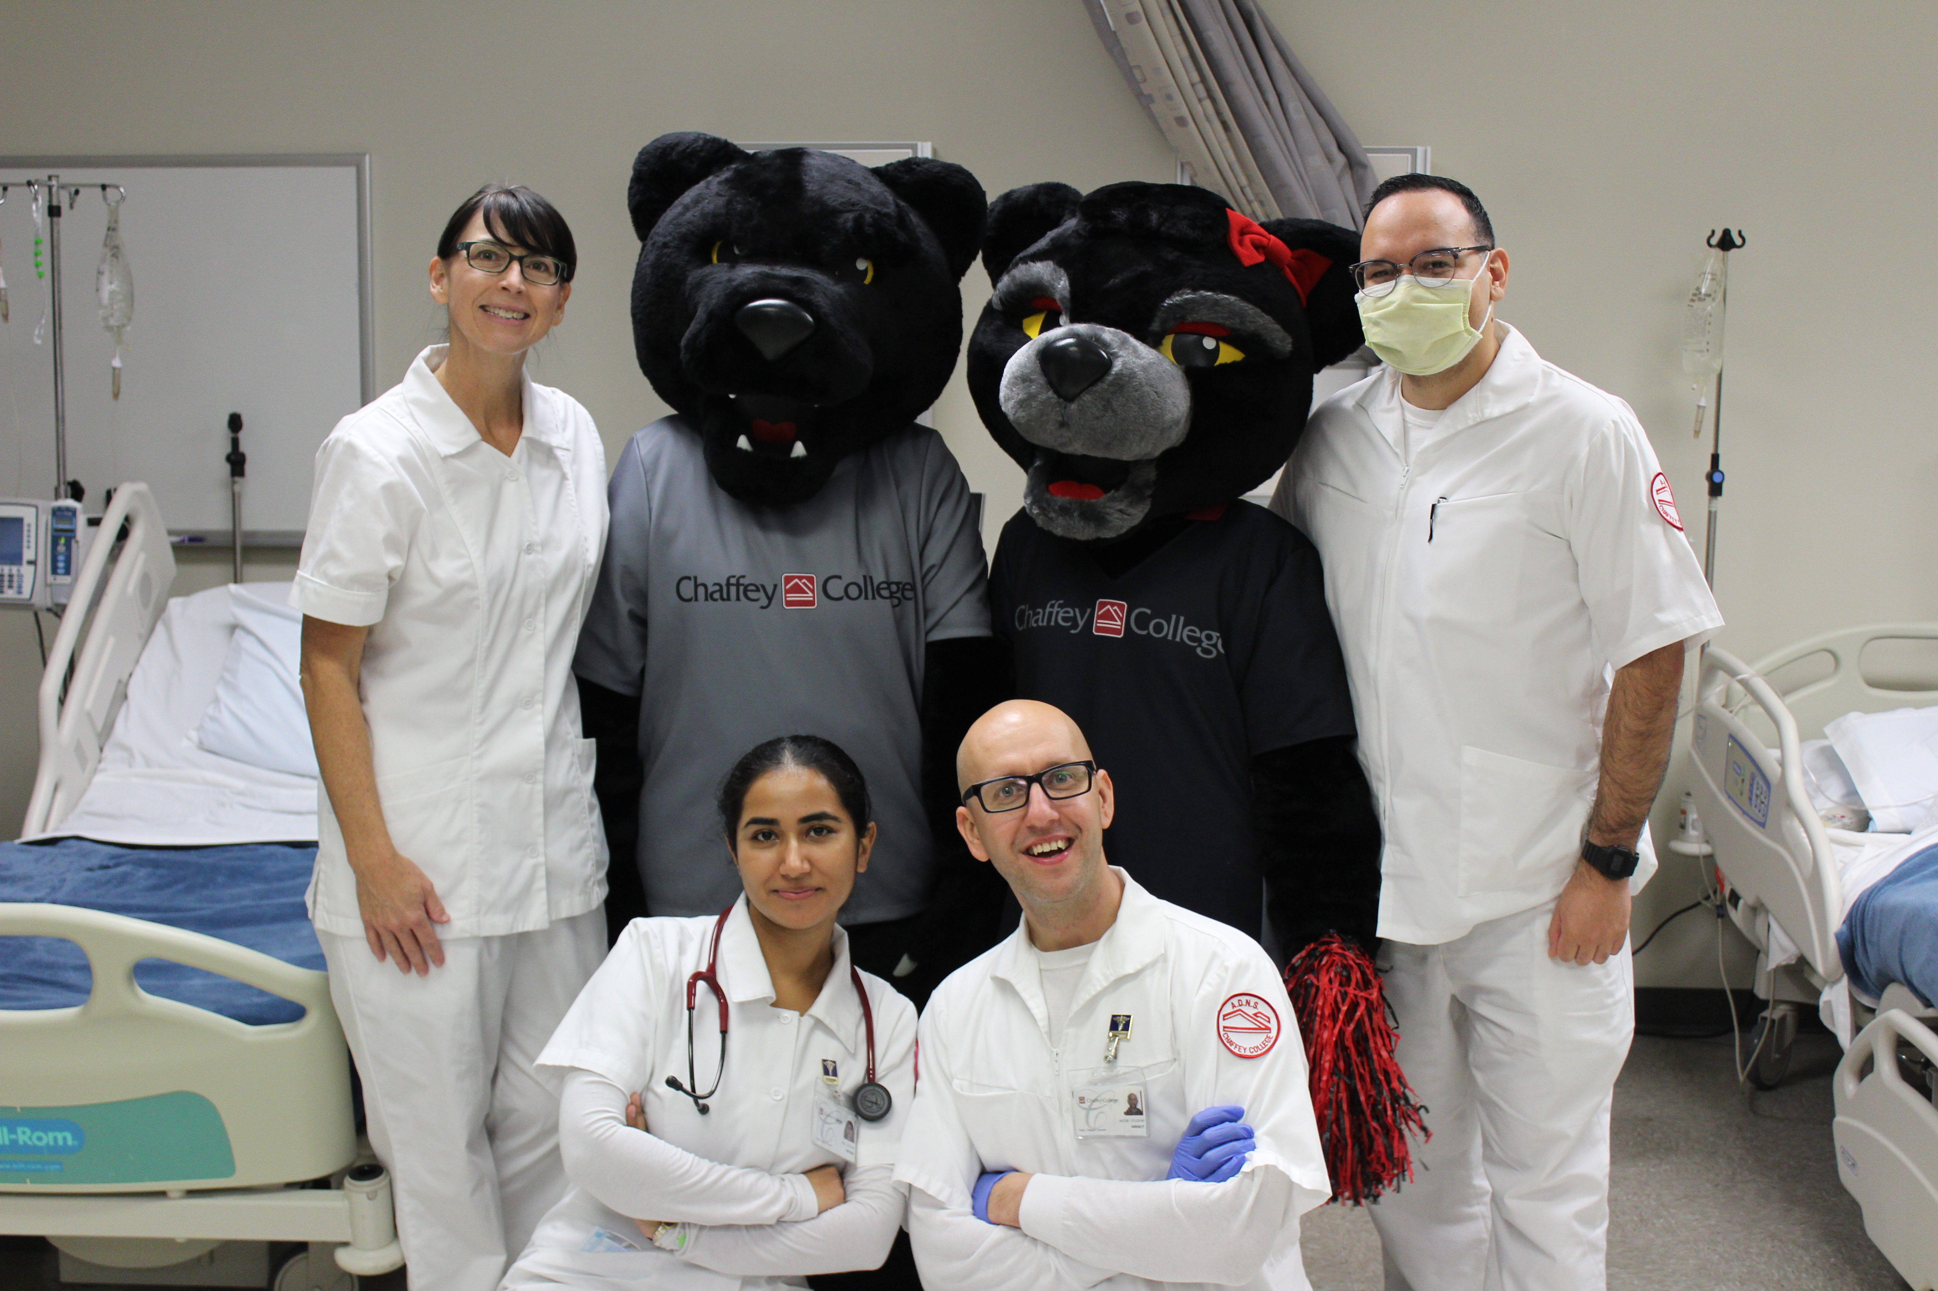
Frequently asked questions
What is meant by “spaces” available?
  This varies per semester see our policies in our handbook, and spaces may be reserved for contract requirements or be limited by our clinical sites
Do you have a wait list?
  We do not hold a wait list
Can another course be changed for Math 401?
  Only another similar course for math for nursing from another college can be equilvant

Slide 26

Next step
Please arrange an appointment with a Chaffey College counselor by calling
909-652-6200
for additional information and assistance

Slide 27
Information regarding nursing education can be obtained from the following agencies
California Board of Registered Nurses (BRN)
  www.rn.ca.gov
  916-322-3350
  PO Box 944210, Sacramento, CA 94244-2100
Accreditation Commission for Education in Nursing (ACEN)
  www.acenursing.org
  404-975-5000
  3343 Peachtree Road NE, Suite 850, Atlanta, Georgia 30326

